Slide 1

Correct-by-Synthesis Reinforcement Learning with temporal Logic constraints¹
(Learning with guarantees)
- Karan Muvvala
Code : github.com/MuvvalaKaran/CoRL

Slide 2
Autonomous Systems and learning
Reinforcement Learning - Qualitative vs Quantitative behaviors
Approach - turn-based zero-sum games, GR(1), and Strategies
Results
Slugs demo

Slide 3
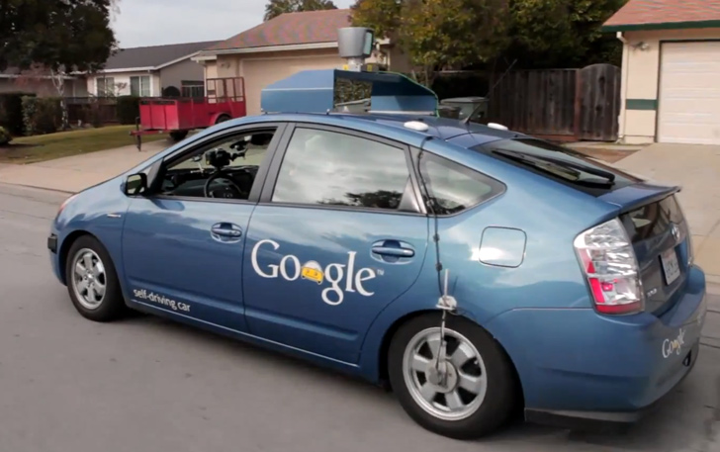
Motivation
Autonomous system are increasingly growing ubiquitous.
More use cases in safety-critical system
Automatic Aircraft traffic system
Factory floor assembly line
Autonomous cars
Key aspect - Decision making
Google self-driving car, https://www.cnn.com/, 2014
Notes:
Autonomous systems are slowly being deployed in real-world scenario.
Growing concern in safety-critical systems.
What makes autonomous unique - DM capability which is a fundamental part of their functionality

Slide 4

Decision Making
2
Learning plays a big role in making decisions
Supervised
Unsupervised
A fundamental challenge in AI and machine learning is learning to make good decisions under uncertainty.
Reinforcement Learning(RL) - learn without any model and without explicitly correcting the actions of the robot.
Notes:
Learning - ability helps reason about a given a decision
Supervised learning - we have truth labels assigned to the data
Task : a learn a function that learn the relationship between the input and the output. E.g classification or regression
Unsupervised learning -the system does not know what is right or wrong and tries to learn the structure of the data.
E.g clustering, representation learning.
RL is a learning paradigm where the robot operate in a uncertain environment. The system employs trial and error methods to come up with a solution for a given problem

Slide 5




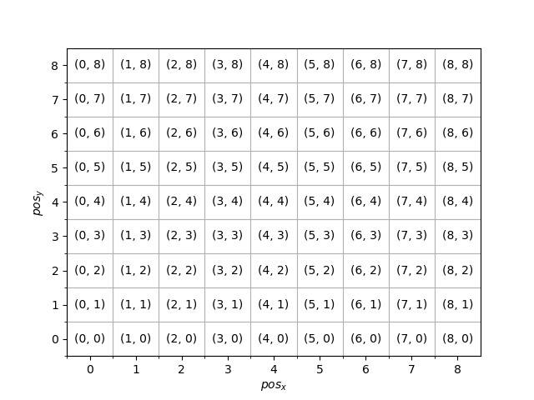
Reinforcement Learning
State s
Reward r
Action a
Basic Idea:
Agent takes an action a in the environment
The environment evolves and the agent then observes the new state s and
The agent receives a reward r
Objective : Given a task what is the most optimal way(𝝅*) to do it.

Slide 6

Challenges
Can we guarantee that the learned strategy(𝝅) will never fail?

Slide 7
Learning with guarantees
We want to guarantee safety while also performing the given task optimally.
Qualitative behaviors - guarantee safety
Quantitative behaviors - guarantee optimality w.r.t some underlying reward function(R ).
Notes:
Satisfy both Quantitative and Qualitative behaviors for a given specification in a fragment of LTL(GR(1))

Slide 8

Can we compute an optimal strategy that satisfies both qualitative as well quantitative performance for a system operating in a unknown environment?
Notes:
Learning with guarantees :
Ensure that the robot satisfies all the constraints during the task execution - Qualitative behaviors
Ensure that the robot perform the given task optimally - Quantitative behaviors

Slide 9
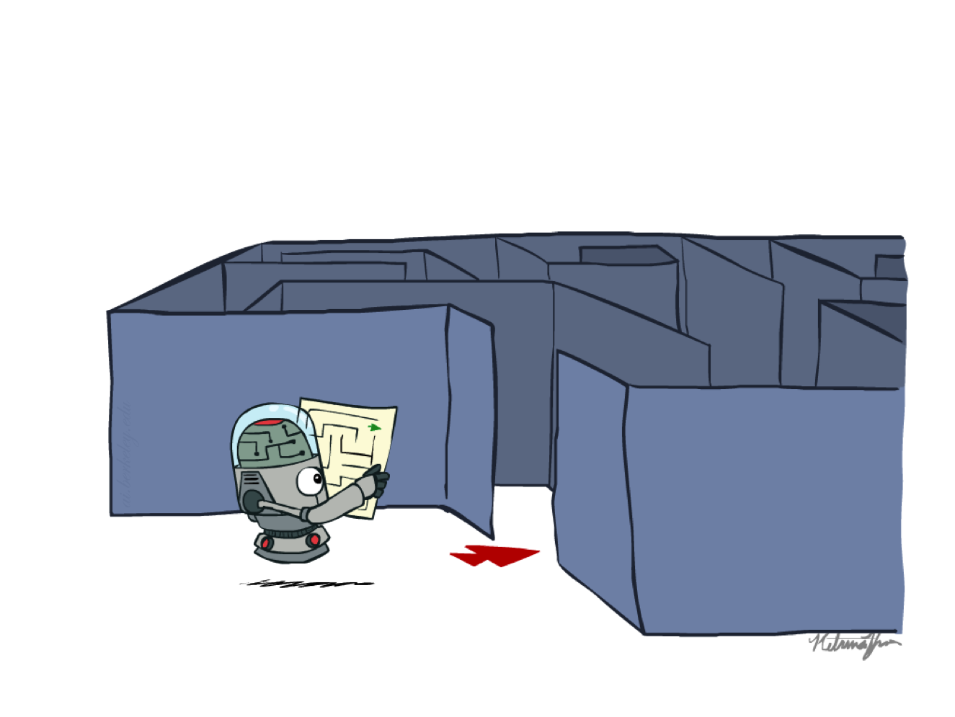
Approach
Model the interaction between the system and the environment as a two-player game (G ).
Specify the given task(𝝋) within the GR(1) framework
Slugs³ - compute a set of permissive strategies for the given specification(𝝋)
Compute the most optimal strategy w.r.t some reward function(R ) within this envelop of permissive strategies.
Notes:
Games help us efficiently reason about qualitative and quantitative aspects of each player
Specify the task in GR1 is a fragment of LTL

Slide 10


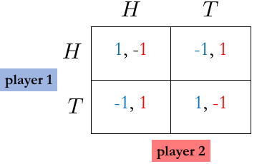
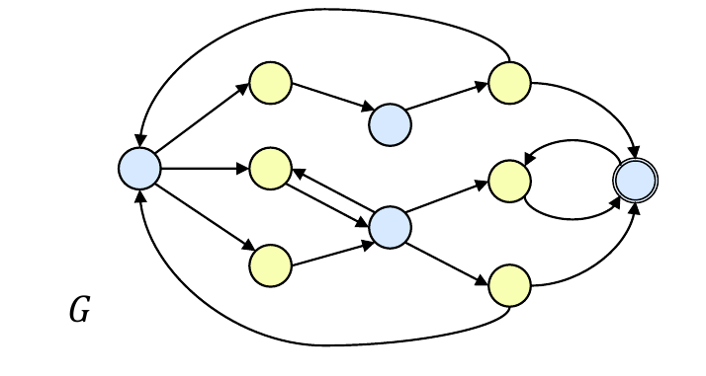
Two-player games
Step 1
Played between two players. Each player has a set of strategies that they can choose from and we have an payoff associated with each outcome.
Two - type of representations
Notes:
We all familiar with chess
Each player in chess has a set of moves at any given instant of time
Each move is associated with a payoff.

Slide 11

Zero-sum games
Step 1
Agents have opposite utilities (values on outcomes).
One tries to maximize(system) his payoff while the other tries to minimize(environment) it.
Adversarial, pure competition
Every zero-sum game has memoryless deterministic strategy
Notes:
The sum of the payoffs for a given play for all the players in the game is equal to 0.

Slide 12
Task Specification(𝝋)
Step 2
The constraints are specified as temporal constraints within the Linear Temporal Logic(LTL) framework.
LTL Syntax :
𝝋 = p | 𝝋₁ ⋀ 𝝋₂ | ㄱ𝝋 | ⚪ 𝝋| 𝝋₁ U 𝝋₂ ; p ∊ AP

Slide 13
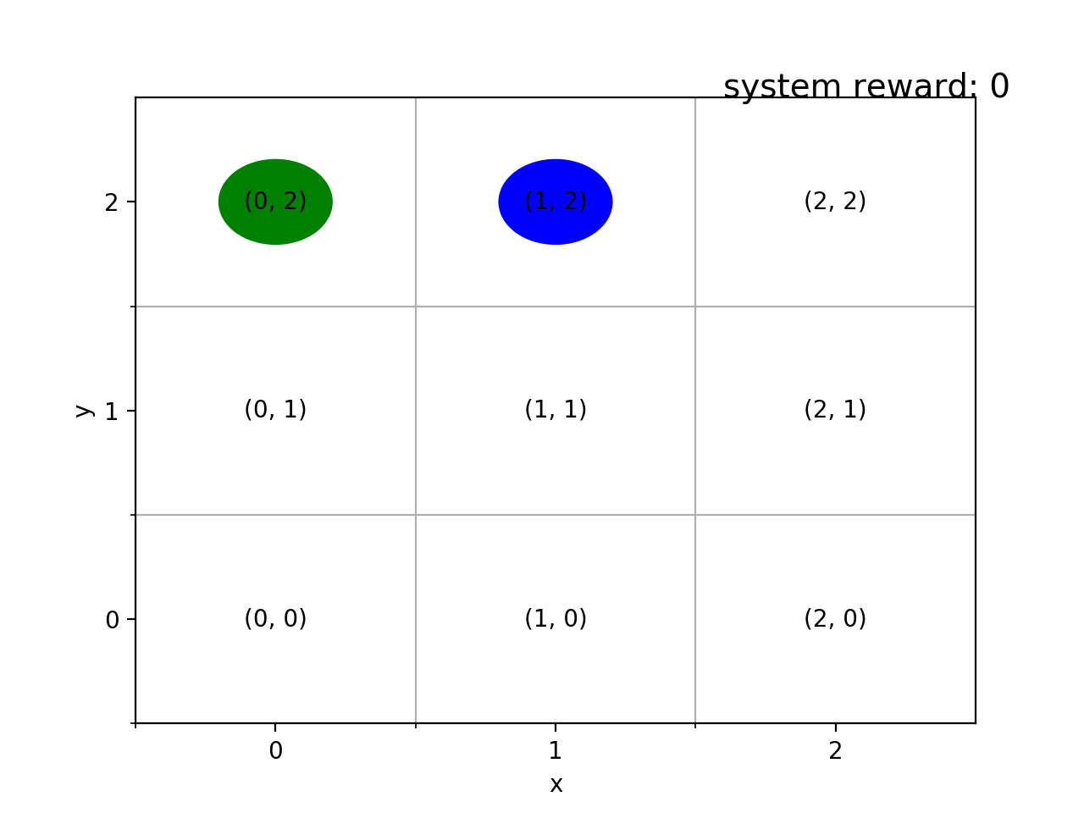
Task Specification(𝝋)
Step 2
LTL Syntax :
𝝋 = p | 𝝋₁ ⋀ 𝝋₂ | ㄱ𝝋 | ⚪ 𝝋| 𝝋₁ U 𝝋₂ ; p ∊ AP
LTL Specification :
𝝋₁ = ㄱ𝓧₈ U ( 𝓧₂ v 𝓧₃)
𝝋₂ = ◽⋄𝓧₄
W₁ = 𝓧₄𝓧₅𝓧₂𝓧₅𝓧₈ W₁ ⊨ 𝝋₁
W₂ = 𝓧₀(𝓧₃𝓧₄)^{ω} W₂ ⊨ 𝝋₂
6
7
8
3
4
5
0
1
2

Slide 14
General Reactivity-1 (GR(1))
Step 2
Why - Automates the task of implementation i.e. we only devise the specification and the implementation is computed automatically
Specification are of the format :
Assumptions ➝ Guarantees
𝝋_{i}ª + 𝝋_{s}ª + 𝝋_{l}ª ➝ 𝝋_{i}^{g} + 𝝋_{s}^{g} + 𝝋_{l}^{g}
𝝋_{i} = initialization 𝝋_{s} = safety (◽) 𝝋_{l} = liveness (◽⋄)
Notes:
GR (1) Synthesis : The synthesis problem has a complexity that is only exponential in the number of atomic propositions in the specification (or polynomial in the size of the state space of the game structure built in the synthesis process)
Safety Specification : something bad will never occur
Liveness specifications : something good will eventually occur

Slide 15
General Reactivity-1 (GR(1))
Step 2
Specification are of the format :
𝝋_{i}ª + 𝝋_{s}ª + 𝝋_{l}ª ➝ 𝝋_{i}^{g} + 𝝋_{s}^{g} + 𝝋_{l}^{g}
Assumptions : Used to state what we know about the behavior of the environment in which the synthesized system is intended to operate
Guarantee : Contains the properties that the synthesized system needs to satisfy if the environment behaves as expected.

Slide 16
Sample Specification(𝝋)

Slide 17

Winning Strategy (𝝅)
Step 3
A Strategy is a mapping from each state to a action.
A strategy is called winning if W ⊨ 𝝋
𝝋 can be used to satisfy qualitative performance
Notes:
And a formula \phi is called realizable if it is winning for the system on game G

Slide 18

Permissive Strategies ( 𝜇_{p})
Step 3
𝜇_{p} - strategy that captures (almost) all possible behaviors of memoryless strategies .
If it includes all winning strategies for the system then it is called maximally permissive( 𝜇_{p}^{max} ) .
Stay

Slide 19
Q-learning
Step 4
Initialize Q-table
It’s a model-free RL algorithm
The algorithm calculates the quality of a state-action pair
Q : S x A ➝ ℝ
Choose an action
Perform action
Measure reward
Update Q-table
Notes:
Q stands for the quality of state-action pair in the give state space (or in our case the game.)

Slide 20

Q-learning properties
Step 4
Q-learning converges to optimal policy/strategy ( 𝜇_{p}*) - even if you’re acting sub-optimally!
Convergence proofs exists even for non episodic tasks. If the discount factor (𝜸) is lower than 1, the action values are finite even if the problem can contain infinite loops.
Caveats:
You have explore enough
You have to eventually make the learning rate small enough
...but not decrease it too quickly
Basically, in the limit, it doesn't matter how you select actions (!)
Notes:
Q-learning converges to optimal policy/strategy ( 𝜇p*) - even if you’re acting sub-optimally!
Convergence proofs exists even for non episodic tasks. If the discount factor (𝜸) is lower than 1, the action values are finite even if the problem can contain infinite loops.
Caveats:
You have explore enough
You have to eventually make the learning rate small enough
...but not decrease it too quickly
Basically, in the limit, it doesn't matter how you select actions (!)

Slide 21
Recap
We can construct a game (G )
Specify the constraints as temporal specification(𝝋) within the GR(1) framework
Compute a set of “valid” behaviors( 𝜇_{p})
Learn the most optimal way( 𝜇_{p}*) to perform the given task w.r.t. R

Slide 22
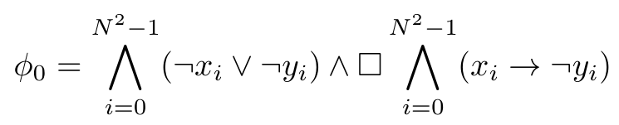
Strategy Synthesis
Task : Remain in a cell diagonally opposite to the environment robot
A_{s} = { up, down, right, left, stay }
A_{e} = { up, down, right, left }
Notes:
Do not go too much into the details.

Slide 23
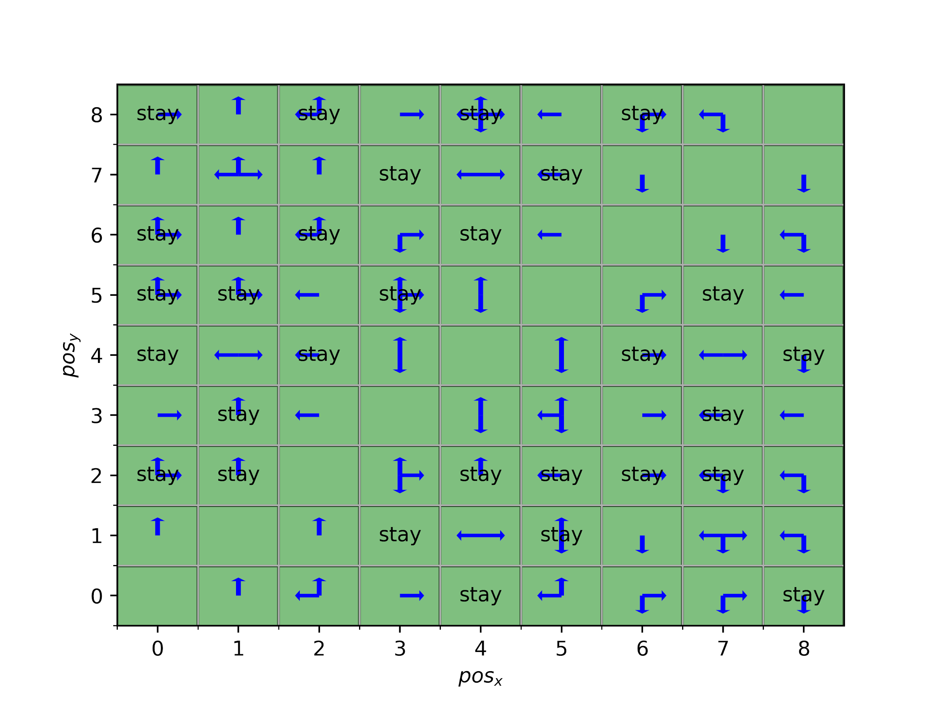
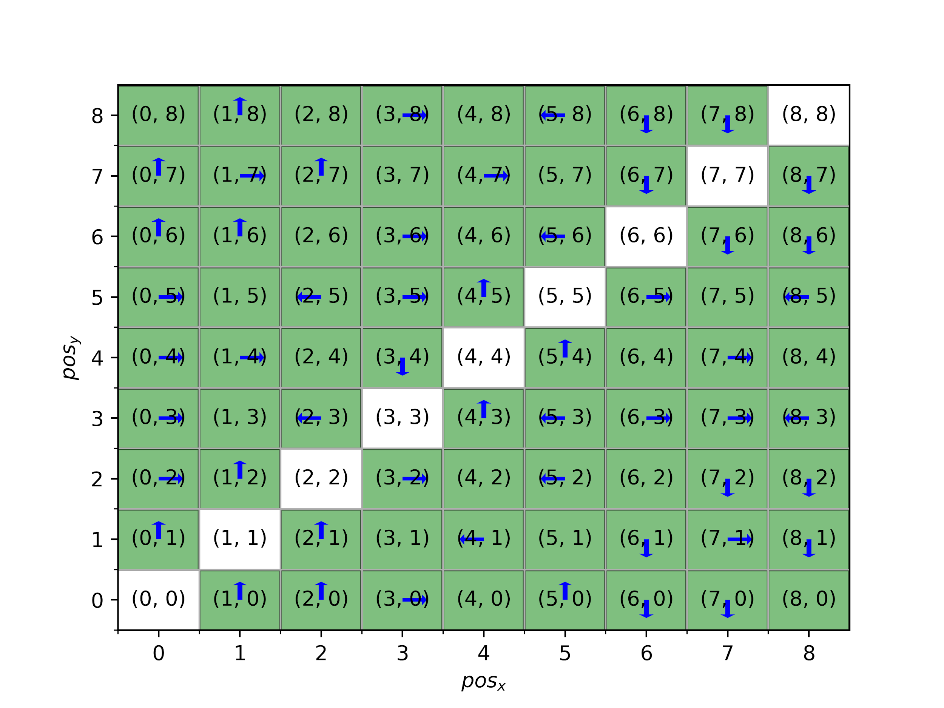
Learned Optimal Policy

Slide 24

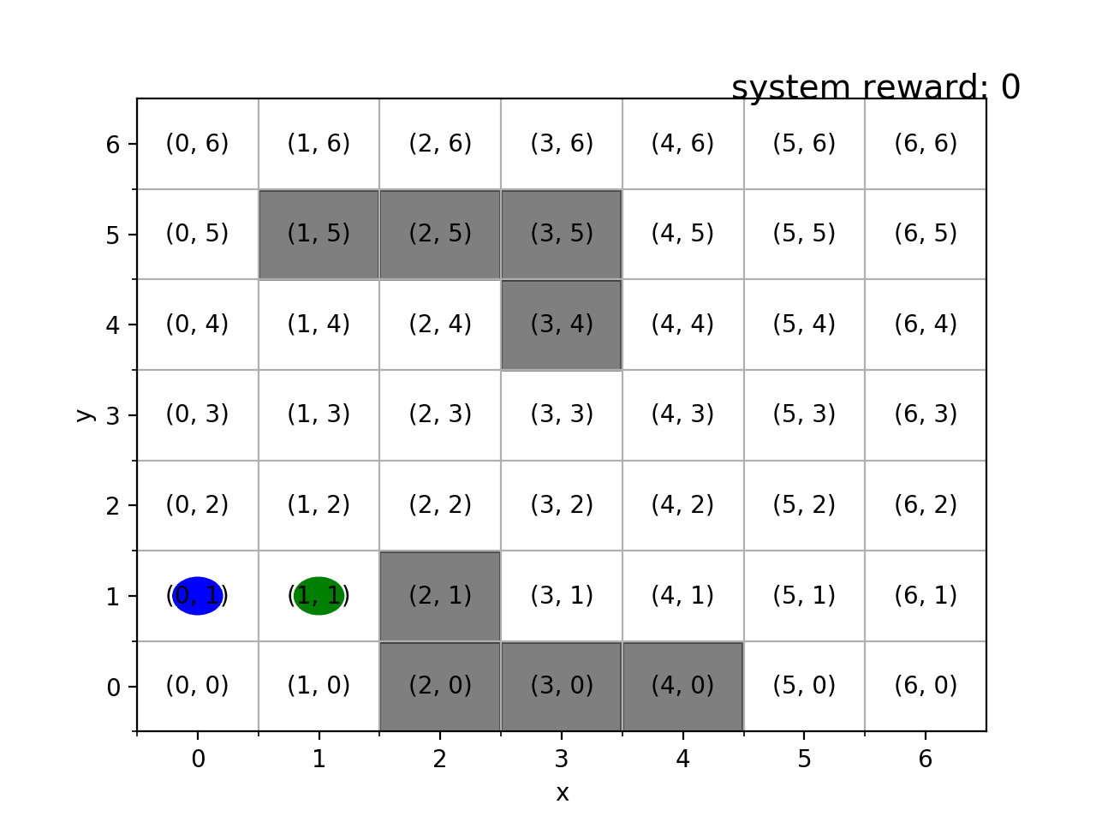
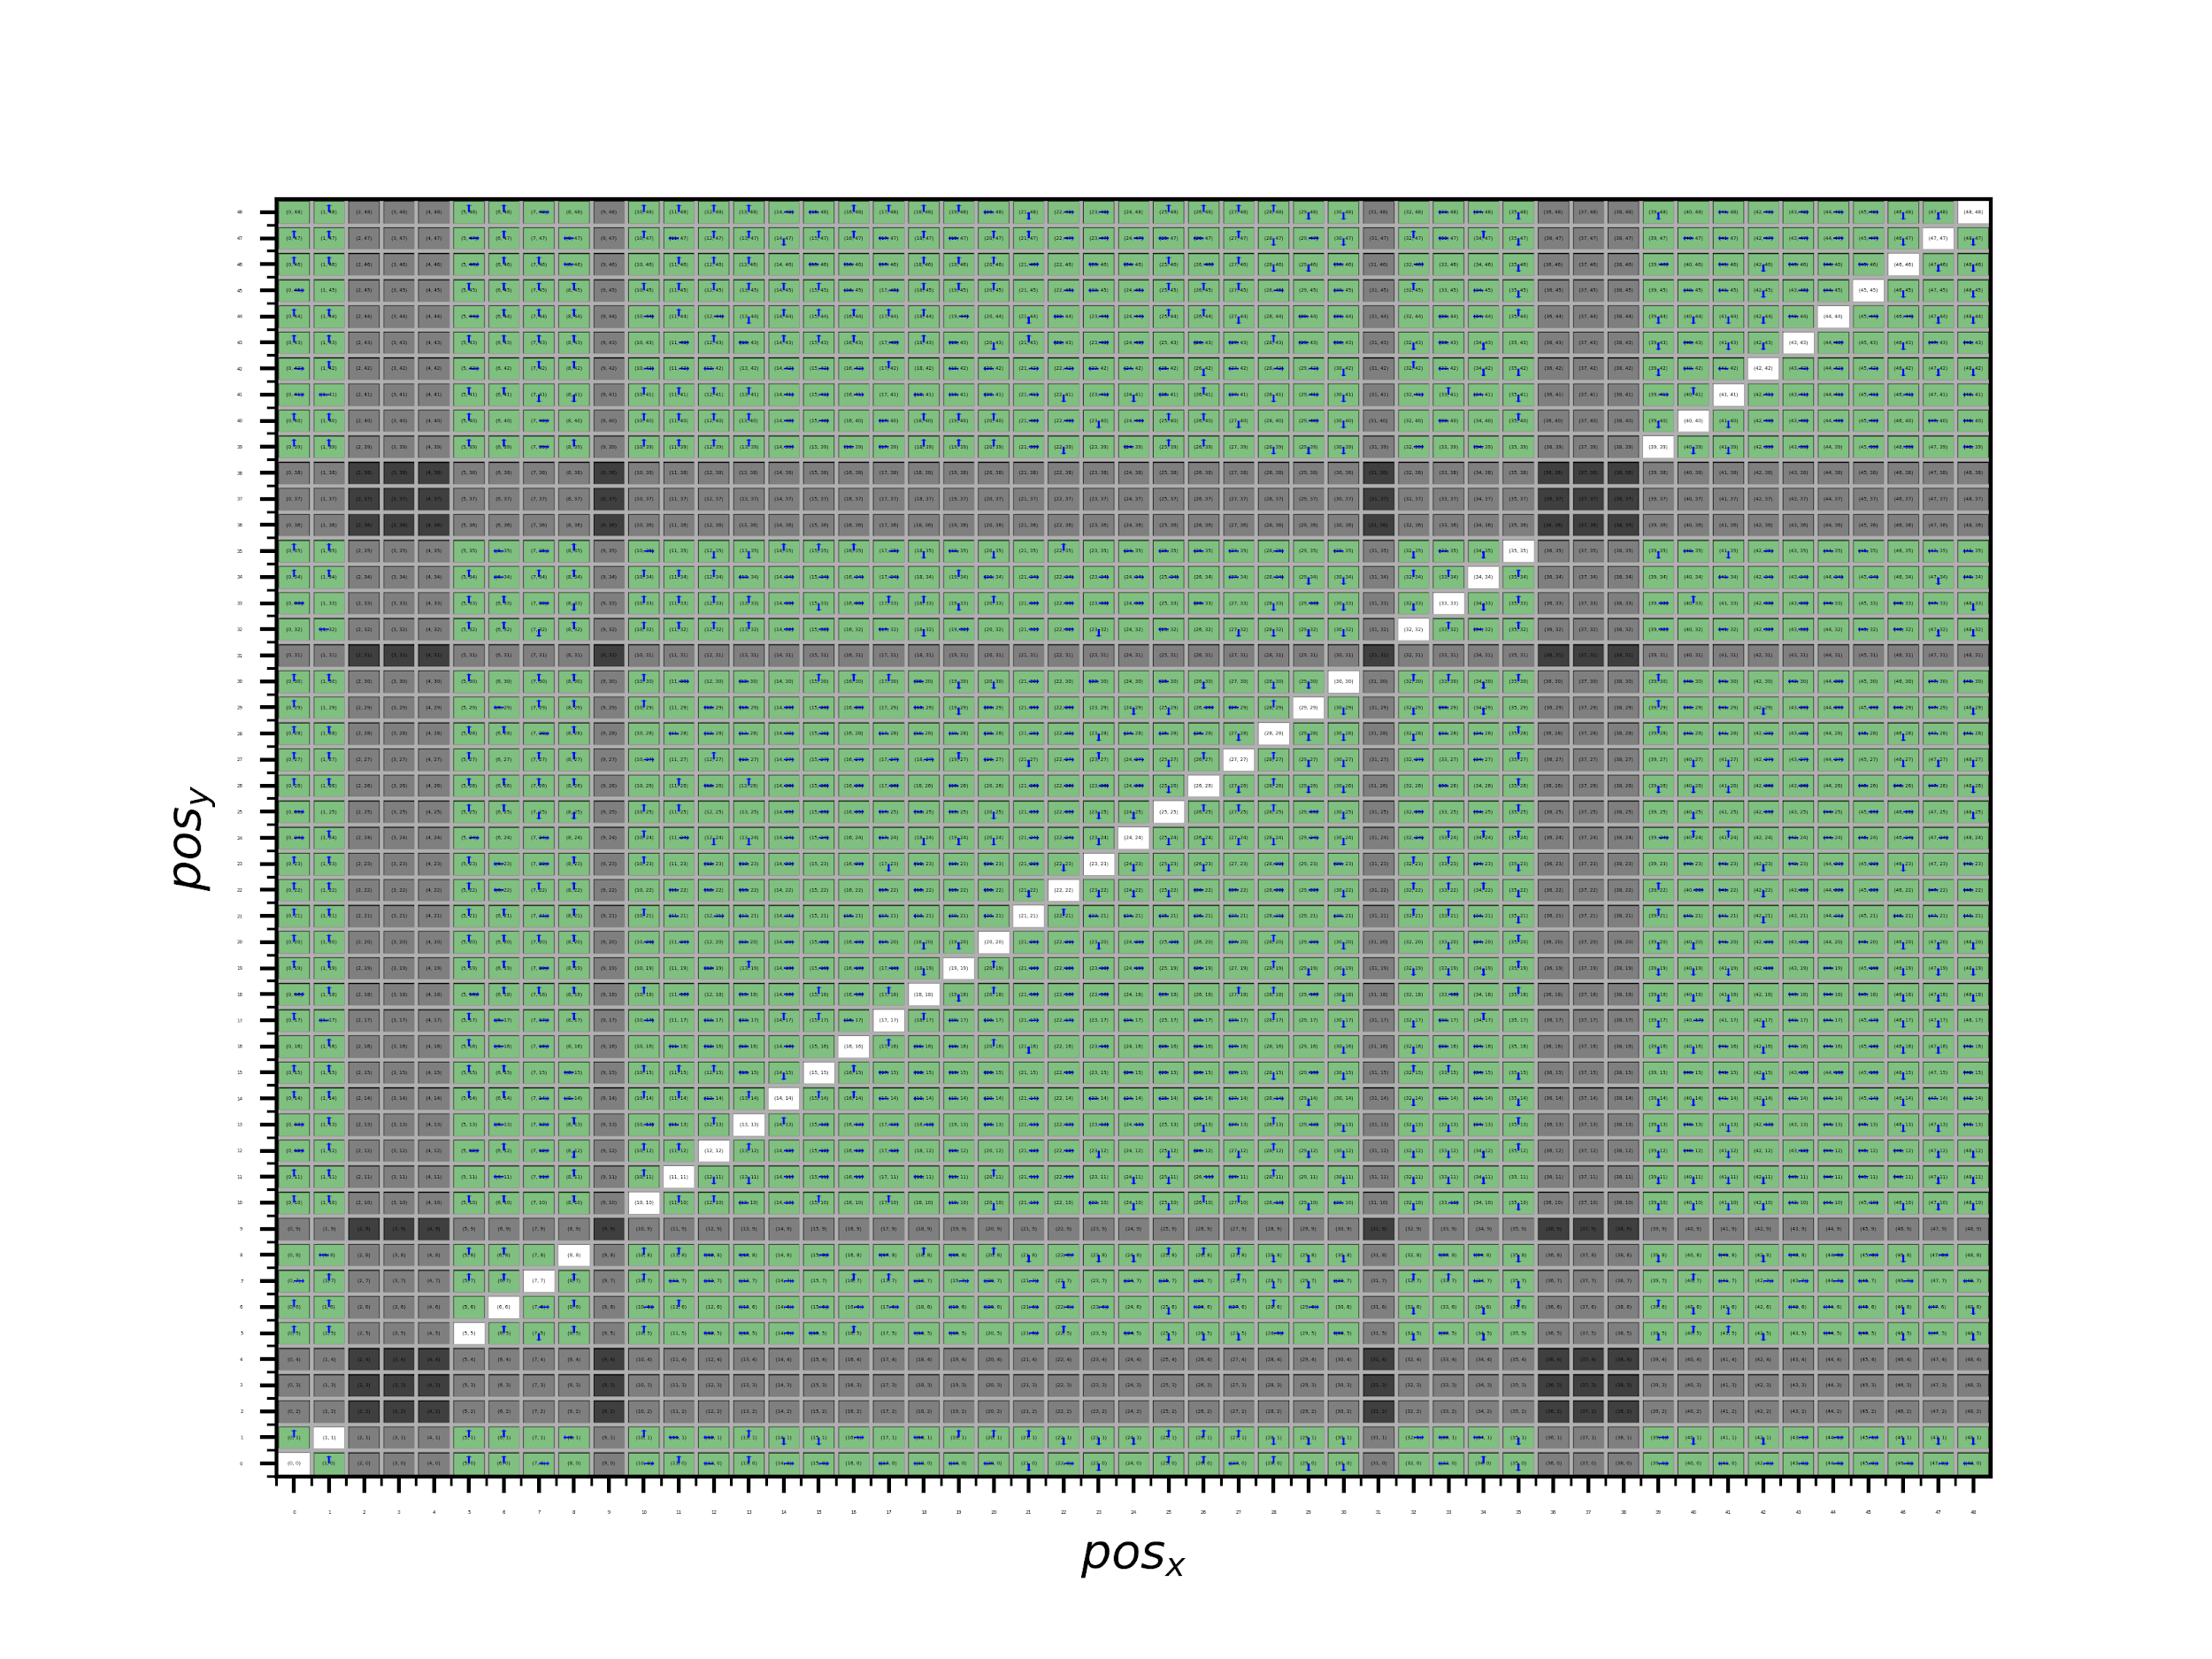
Results
Notes:
Shows GIFs and then maybe talk about the state explosion problem.

Slide 25
References
Wen Min, Rüdiger Ehlers, and Ufuk Topcu. ”Correct-by-synthesis reinforcement learning with temporal logic constraints.” 2015 IEEE/RSJ, International Conference on Intelligent Robots and Systems (IROS)IEEE, 2015.
Robot Illustrations (available at) - http://ai.berkeley.edu/lecture_slides.html
R. Ehlers, V. Raman, and C. Finucane. Slugs GR(1) synthesizer 2013– 2014. Available at https://github.com/LTLMoP/slugs

Slide 26
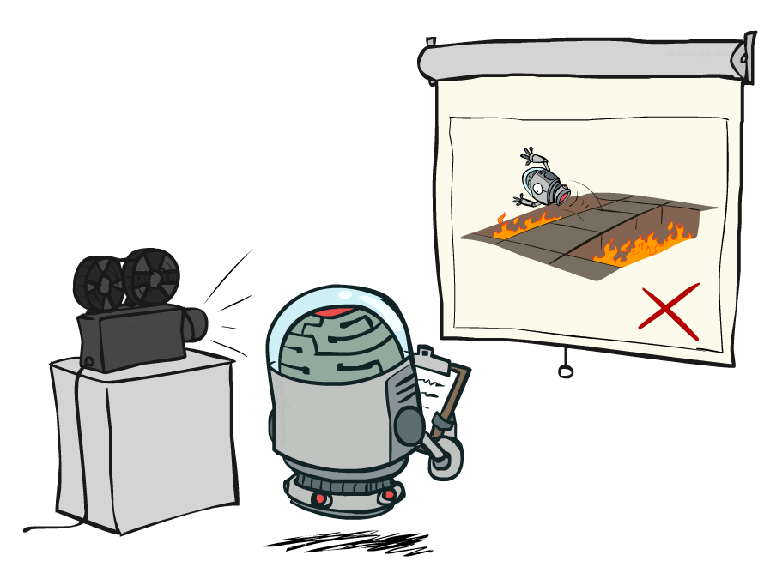
Thank you
Slugs Demonstration

